Slide 1
GQ(I)M Continue

Slide 2
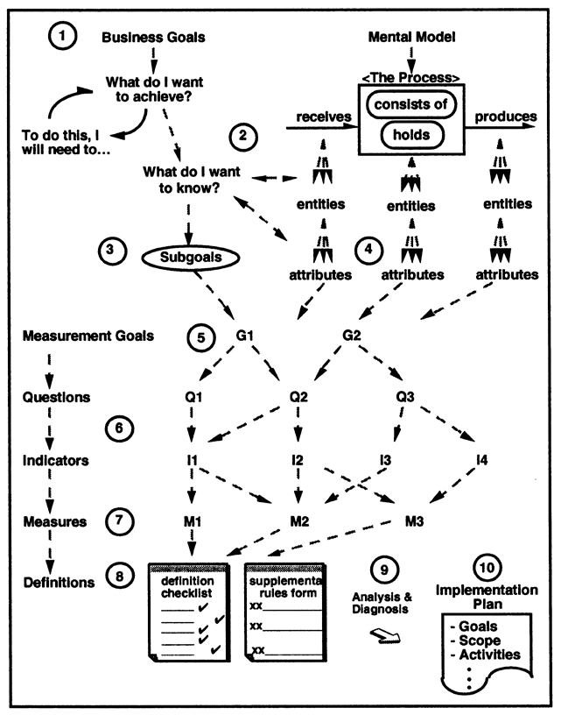
GQ(I)M: Next Steps
Notes:
https://www.tutorialspoint.com/software_engineering/case_tools_overview.htm

Slide 3
GQ(I)M Next Steps
Identify quantifiable questions and indicators that will be used to achieve measurement goals.
Identify data elements that will be collected to construct the indicators.
Define measures to be used, and make these definitions operational.
Identify actions that will be taken to implement the measures.
Prepare a plan for implementing the measures.
Notes:
https://www.tutorialspoint.com/software_engineering/case_tools_overview.htm

Slide 4
Step 6: Identify Indicators
What is an indicator?
Indicator is a display of one or more measurement results that is designed to communicate or explain the significance of those results to the user.
Why is it useful?
Seeing how measurement data will be displayed helps clarify exactly what must be measured.
Notes:
https://www.tutorialspoint.com/software_engineering/case_tools_overview.htm

Slide 5
Step 6: Identify Indicators
How to proceed?
Select a measurement goal
Identify quantifiable questions related to this goal that you would like to be answered.
Prepare sketches for displays (indicators) that will help you address your questions.
Prioritize the indicators and identify the ones that will be most useful to you.
Notes:
https://www.tutorialspoint.com/software_engineering/case_tools_overview.htm

Slide 6
Quantifiable Questions
What is quantifiable question?
How is it different from questions in Step 2?
Question: “Is there sufficient code inspection?”
(addresses a generic class of entities; answer: not necessarily numeric or logic)
Quantifiable Question: “What percentage of the code in Module A is inspected?”
(addresses a specific entity; answer: numeric or logic)
Notes:
https://www.tutorialspoint.com/software_engineering/case_tools_overview.htm

Slide 7
Example
Measurement Goal 1: Development Team
Questions: questions that we would like answered are:
What are the personality factors of all the development team members?
What is the rate at which individual engineers involved in software development produce software and associated documentation?
What design and analysis techniques are most effective in product development?
Is the development team structured to effectively utilize members’ skills?
How many years of experience do the team members have and in what domain?
Notes:
https://www.tutorialspoint.com/software_engineering/case_tools_overview.htm

Slide 8
Example
Measurement Goal #9: CASE Tools
Questions:
What percentage of the budget is available for tools?
How much would CASE tools cost?
Is the increase in productivity offset by the cost of the tools?
How long will we have to train employees with the tools?
Notes:
https://www.tutorialspoint.com/software_engineering/case_tools_overview.htm

Slide 9
Indicator a
Measurement Goal #9: CASE Tools
What percentage of the budget is available for tools?
Notes:
https://www.tutorialspoint.com/software_engineering/case_tools_overview.htm

Slide 10
Indicator b
Measurement Goal #9: CASE Tools
How much would CASE tools cost?
Cost in 100$
Notes:
https://www.tutorialspoint.com/software_engineering/case_tools_overview.htm

Slide 11
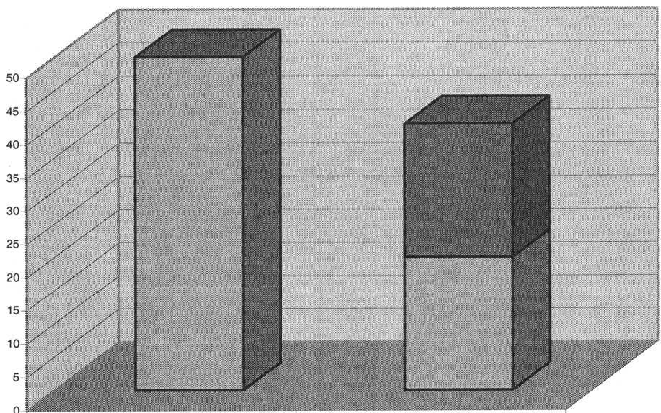
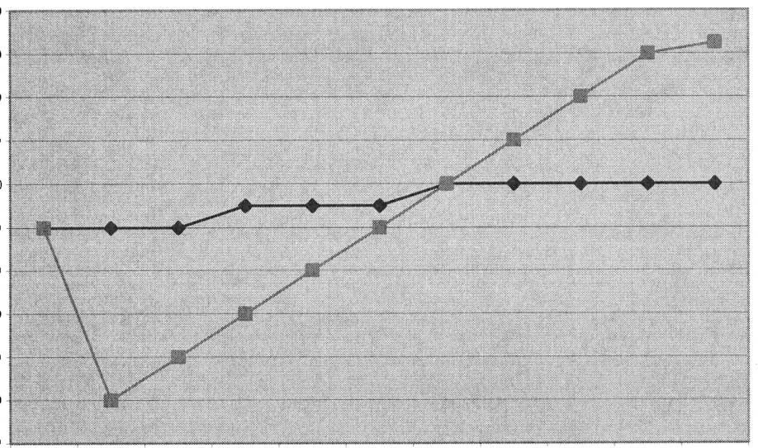

Indicator c & d
Measurement Goal #9: CASE Tools
Is the increase in productivity offset by the cost of the tools?
Productivity LOC
Average cost per KLOC
Case tool cost
before
LOC
cost
after
Time
without
with
c
d
Notes:
https://www.tutorialspoint.com/software_engineering/case_tools_overview.htm

Slide 12
Indicator e
Measurement Goal #9: CASE Tools
How long will we have to train employees with the tools?
Days of training
Notes:
https://www.tutorialspoint.com/software_engineering/case_tools_overview.htm

Slide 13
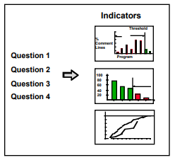
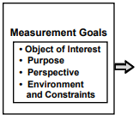
Step 6: Identify Indicators
Notes:
https://www.tutorialspoint.com/software_engineering/case_tools_overview.htm

Slide 14
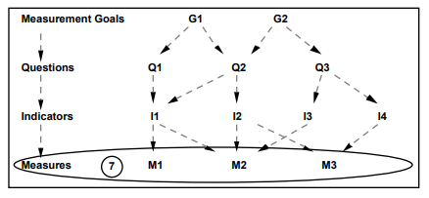
Step 7: Identify Data Elements
At this Step we must identify:
Data elements that must be collected to construct the indicators identified in Step 6
Notes:
https://www.tutorialspoint.com/software_engineering/case_tools_overview.htm

Slide 15
Step 7: Identify Data Elements
Data elements identification involves:
Preparing a list of data items (attributes).
Preparing a checklist cross-referencing data items and indicators, i.e., which data element is used by which indicator.
Definitions for data items including scales, ranges and precision will be added in the next step.
Notes:
https://www.tutorialspoint.com/software_engineering/case_tools_overview.htm

Slide 16
Example
List the data elements vs. the indicators identified in Step 6.
What data are required? | a | b | c | d | e
Total Money available for project | x
Total money available for CASE tools | x
Lines of source code |  |  | x | x
Development effort |  |  | x
Type of Case tool |  | x |  | x
Average cost per LOC |  |  |  | x
Training effort |  |  |  |  | x
Notes:
https://www.tutorialspoint.com/software_engineering/case_tools_overview.htm

Slide 17
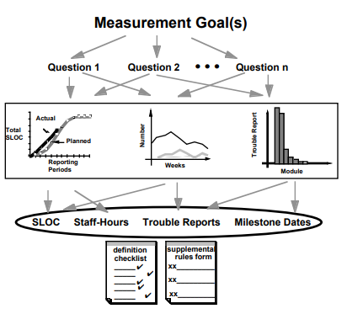
Step 7: Identify Data Elements
Using Indicators to Identify Data Elements
Notes:
https://www.tutorialspoint.com/software_engineering/case_tools_overview.htm

Slide 18
Step 8: Define Measure
What is a measure definition?
A measure definition is a semi-formal specification for the object to be measured.
Why is it useful?
It is extremely useful to clarify the implicit assumptions, what is included and what is not in the measurement.
Notes:
https://www.tutorialspoint.com/software_engineering/case_tools_overview.htm

Slide 19
Step 8: Define Measure
After the measures are identified they must be defined clearly
Definitions must indicate:
Name and short description
Scale
Range of variation
Precision required
Implicit and explicit assumptions related to measurement, what is included and what is not.
Anything else that may help interpret the measurement procedure and values correctly
Notes:
https://www.tutorialspoint.com/software_engineering/case_tools_overview.htm

Slide 20
Example
Measuring the height of school children, between the ages of 6 and 12
Measure Definition 1: Height is standing height, measured in inches.
Measure Definition 2: Height is standing height (exclusive of piled up hair and hats), measured in inches, bare foot, on a calibrated scale, by a trained nurse, between 8 and 9 o'clock in the morning.
Which set of height measurements is expected to be more reliable, more consistent across schools, and more fit for interpretation?
Notes:
https://www.tutorialspoint.com/software_engineering/case_tools_overview.htm

Slide 21
Example
The same applies to definitions such as:
The measure for software size is the number of non-commented, nonblank, executable source statements.
The measure for cost is the total direct labour hours from the start of the project.
These are less-specified examples of definitions of measures that may lead to misinterpretations of measurements and recorded values.
Notes:
https://www.tutorialspoint.com/software_engineering/case_tools_overview.htm

Slide 22
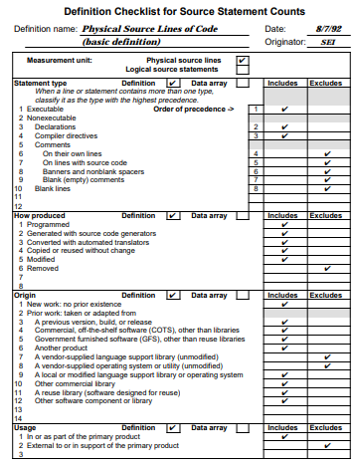
Example
Measures can be best defined using
Definition checklists & descriptive forms
Advantages: Making explicit many issues, assumptions and decisions that usually go unrecorded.
Notes:
https://www.tutorialspoint.com/software_engineering/case_tools_overview.htm

Slide 23
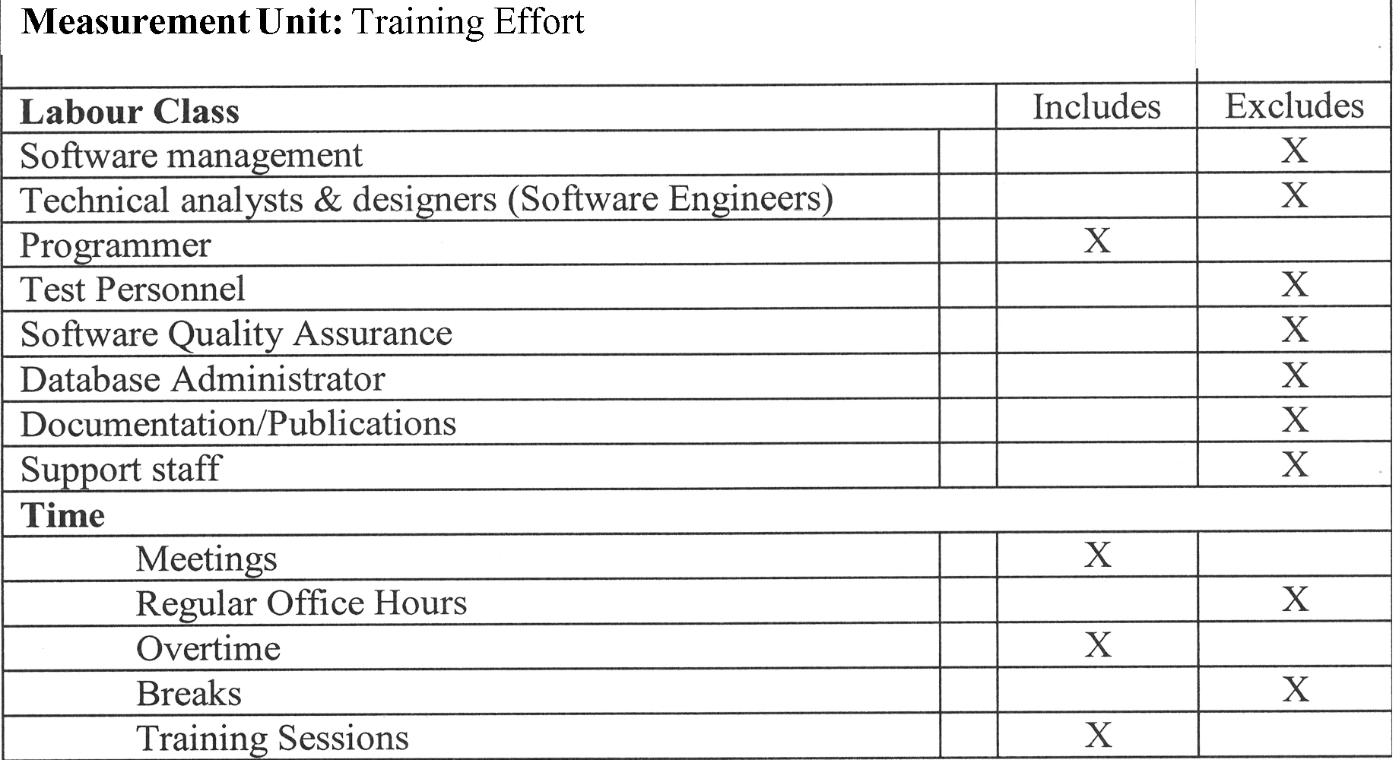
Example
Notes:
https://www.tutorialspoint.com/software_engineering/case_tools_overview.htm

Slide 24
Step 9: Identify Actions to Implement Measures
This step is to assemble information about the current status and use of the measures, so as to prepare a plan for implementing the measures defined, through:
Analysis &
Diagnosis &
Actions
Notes:
https://www.tutorialspoint.com/software_engineering/case_tools_overview.htm

Slide 25
Analysis
Analysis means identifying the measures that the organization is using now and understanding how it is collecting them using questions such as:
What data elements are required for our goal-driven measures?
Which data elements are collected now?
How are they collected?
What are the processes that provide the data?
How are the data elements stored and reported?
Notes:
https://www.tutorialspoint.com/software_engineering/case_tools_overview.htm

Slide 26
Diagnosis
Diagnosis means evaluating the data elements that the organization is collecting now, determining how well they meet the needs of new measurements, and proposing appropriate actions for:
Using the data, adapting data to the needs, adapting needs to the data and obtaining what is missing.
By asking questions such as:
What existing measures and processes can be used to satisfy data requirements?
What elements of measurement definitions or practices must be changed or modified?
What new or additional processes are needed?
Notes:
https://www.tutorialspoint.com/software_engineering/case_tools_overview.htm

Slide 27
Action
Action means translating the results of the analysis and diagnosis into implementable steps.
Action identifies elements that measurement plan will be built upon. Some pre-planning tasks are:
Identify sources of data within existing software process(es).
Define methods that will be used to collect and report data.
Identify tools that will be required to support collecting, reporting, and storing data.
Determine requirements (constraints) for points in time and frequencies of measurement.
Document data collection procedures.
Identify responsible persons and organizations.
Determine where, how, and when to collect and report.
Create sketches for the data collection records will be used.
Notes:
https://www.tutorialspoint.com/software_engineering/case_tools_overview.htm

Slide 28
Action Item Checklist
Define data elements (Step 8).
Define frequencies of collection and points in the process where measurements will be made.
Define timelines required for moving measurement results from the points of collection to databases or users.
Create forms and procedures for collecting and recording data.
Define how data is to be stored and how data will be accessed. Identify who is responsible for designing the database and for entering, retaining, and overseeing the data.
Determine who will collect and access data. Assign responsibilities for these actions.
Define how data will be analyzed and reported.
Identify supporting tools that must be developed or acquired to help you automate and administer the process.
Prepare a process guide for collecting data.
Notes:
https://www.tutorialspoint.com/software_engineering/case_tools_overview.htm

Slide 29
Step 10: Prepare a Plan
Measurement implementation plan is based on analysis, diagnosis and actions (Step 9)
Measurement plan template includes:
Objective
Description
Implementation
Sustained operations
Notes:
https://www.tutorialspoint.com/software_engineering/case_tools_overview.htm

Slide 30
Step 10: Plan Template
Objective
List the principal objectives of this measurement implementation effort.
Identify the measures to be implemented, explain why they are important to the organization, and summarize the expected outcomes.
Notes:
https://www.tutorialspoint.com/software_engineering/case_tools_overview.htm

Slide 31
Step 10: Plan Template
Description
Background
A brief history of the events that have led to or motivated this plan. Describe the origins of the plan, the work that has been done to date and who participated. Relate the planned actions to other existing or concurrent measurement activities within the organization and (if appropriate) in those of customers or suppliers.
Goals
List and explain the goals that motivate and guide the activities under this plan by identifying three kinds of goals: (a) business goals, (b) measurement goals, and (c) the goals of this plan.
Notes:
https://www.tutorialspoint.com/software_engineering/case_tools_overview.htm

Slide 32
Step 10: Plan Template
Scope
Relate the measures that this plan implements to the measurement goals. Do the measures apply to new projects only? To development projects? To large or small programs? To only certain divisions or departments? Who are the major stakeholders? Who will be affected by the measurement practices, processes, and methods? Who will use the results? Identify the time span over which this plan is to be effective.
Relationship to other software process improvement efforts
Describe how the measurement efforts in this plan relate to other process improvement activities at the organization, such as the CMM, the Baldrige Award, or ISO 9000 certification.
Relationship to other functional activities
Describe how the measurement efforts in this plan relate to other functional groups and activities at the organization, such as cost estimating, time and effort reporting, cost accounting, and quality assurance.
Notes:
https://www.tutorialspoint.com/software_engineering/case_tools_overview.htm

Slide 33
Step 10: Plan Template
Implementation
Describe the actions that are to be taken to implement the measures identified in the Description. It includes detailed information on
Activities, products, and tasks
Schedules
Resources
Responsibilities
Measurement and monitoring Assumptions
Risk management
Notes:
https://www.tutorialspoint.com/software_engineering/case_tools_overview.htm

Slide 34
Step 10: Plan Template
Sustained Operations
Describe the actions that will be taken to sustain and use the measures implemented.
Assign resources and responsibilities and make provisions for continuing evolution.
Describe the practices that will be used to evaluate and monitor the effectiveness of the measures and to assess their business value and their effects on organizational performance.
Alternatively, if appropriate, provide direction and resources for preparing an operational plan for sustaining the collection, use, retention, evolution, and evaluation of these measures.
Notes:
https://www.tutorialspoint.com/software_engineering/case_tools_overview.htm

Slide 35
CMMI
The CMMI for Development provides an ordinal ranking of development organizations from initial (the least predictable and controllable, and least understood) to optimizing (the most predictable and controllable)
Initial: Level 1 processes are ad hoc and “success depends on the competence and heroics of the people in the organization.”
Managed: Level 2 processes are planned; “the projects employ skilled people … have adequate resources … involve relevant stakeholders; are monitored, controlled, and reviewed … .”
Defined: Level 3 “processes are well characterized and understood, and are described in standards procedures, tools, and methods.
Quantitatively managed: A Level 4 “organization and projects establish quantitative objectives for quality and process performance and use them as criteria in managing projects.”
Optimizing: A Level 5 “organization continually improves its processes based on a quantitative understanding of its business objectives and performance needs” (CMMI Product Team 2010).
Notes:
https://www.tutorialspoint.com/software_engineering/case_tools_overview.htm

